Slide 1
Select Tag
The <select>….</select> tag creates a drop down list to accept a user input from a list of items.
Attribute | Value | Description
autofocus | autofocus | Specifies that the drop-down list should automatically get focus when the page loads
disabled | disabled | Specifies that a drop-down list should be disabled
multiple | multiple | Specifies that multiple options can be selected at once
name | name | Defines a name for the drop-down list
required | required | Specifies that the user is required to select a value before submitting the form
size | number | Defines the number of visible options in a drop-down list

Slide 2
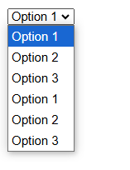
<select name="dropdown" id="dropdown">
<option value="option1">Option 1</option>
<option value="option2">Option 2</option>
<option value="option3">Option 3</option>
</select>

Slide 3
Option Tag
The <option>…</option> tags inside the <select>….</select> element define an option in the drop down list.
<select>
<option>………..</option>
<option>………..</option>
</select>

Slide 4
Attribute | Value | Description
disabled | disabled | Specifies that an option should be disabled
selected | selected | Specifies that an option should be pre-selected when the page loads
value | text | Specifies the value to be sent to a server

Slide 5
Optgroup Tag
The <optgroup>….</optgroup> tag helps to group related choices, when we have a long list of option to select from the drop-down list created using the <select> tag.
<select>
<optgroup>
<option>……</option>
</optgroup>
<optgroup>
<option>……</option>
</optgroup>
</select>

Slide 6
Attribute | Value | Description
disabled | disabled | Specifies that an option-group should be disabled

Slide 7
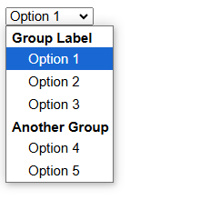
<select>
<optgroup label="Group Label">
<option value="option1">Option 1</option>
<option value="option2">Option 2</option>
<option value="option3">Option 3</option>
</optgroup>
<optgroup label="Another Group">
<option value="option4">Option 4</option>
<option value="option5">Option 5</option>
</optgroup>
</select>

